Slide 1
Chapter 1
Introduction to Systems Analysis and Design

Slide 2
Learning Objectives (1 of 3)
After this chapter, you will be able to:
Describe the impact of information technology on society
Describe the five main components of an information system
Explain Internet business strategies and relationships, including B2C and B2B
Explain how to use business profiles and models

Slide 3
Learning Objectives (2 of 3)
Understand the seven types of information systems used in business
Describe the types of information the four classes of users need
Distinguish among structured analysis, object- oriented analysis, and agile systems development methods
List the tools that enable the systems analyst to develop, manage, and maintain large-scale information systems

Slide 4
Learning Objectives (3 of 3)
Explain the seven main functions of the information technology department
Describe the roles and responsibilities of a systems analyst within the enterprise

Slide 5
Information Technology (1 of 2)
Combination of hardware and software products and services
Used to manage, access, communicate, and share information
Changing nature of information technology
Change is dramatic and continuous
Advances influence change in business organizations

Slide 6
Information Technology (2 of 2)
Systems analysis and design
Step-by-step process for developing high-quality information systems
Information systems: technology, people, and data performing certain business functions
What does a systems analyst do?
Plans, develops, and maintains information
Manages IT projects, conducts meetings, delivers presentations, and writes memos, reports, and documentation

Slide 7
Information Systems (1 of 5)
System: set of related components that produces specific results
Mission-critical systems: vital to operations
All systems require input data
Data: basic facts that serve as raw material
Information: data transformed into output

Slide 8
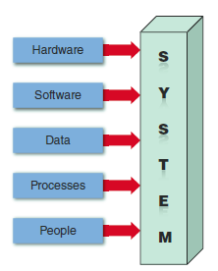
Information Systems (2 of 5)
FIGURE 1-4 An information system needs these components.

Slide 9
Information Systems (3 of 5)
Hardware
Physical layer of information system
Moore’s Law: transistors on an integrated circuit chip double about every 24 months
Software: controls hardware
System software
Manages hardware components
Application software
Support day-to-day business
Horizontal, vertical, and legacy systems

Slide 10
Information Systems (4 of 5)
Data
Stored in tables
Processes
Describe tasks and business functions performed to achieve specific results
People
Stakeholders: individuals interested in an information system

Slide 11
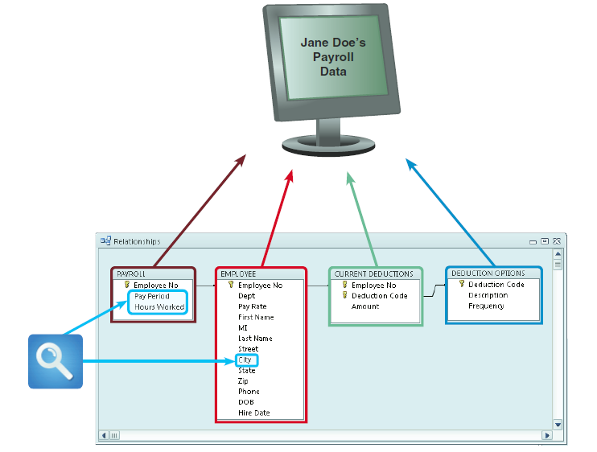
Information Systems (5 of 5)
FIGURE 1-6 In a typical payroll system, data is stored in separate tables that are linked to form an overall database.

Slide 12
Internet Business Strategies (1 of 3)
Trends
Rapidly increasing globalization
Technology integration for seamless information access
Rapid growth of cloud-based computing and services

Slide 13
Internet Business Strategies (2 of 3)
The Internet Model
Ecommerce (electronic commerce)
User interface enables communication between a data-base management software and a web-based server
Mobile devices interact with the system using apps

Slide 14
Internet Business Strategies (3 of 3)
B2C (business-to-customer)
In a single convenient session, customers can:
Do research and compare prices and features
Check availability and arrange delivery
Choose payment methods
B2B (business-to-business)
Ecommerce was initially carried out using electronic data interchange (EDI)
Most firms use supply chain management (SCM) software
Helps manage inventory levels, costs, and suppliers

Slide 15
Modeling Business Operations (1 of 3)
Business profile
Overview of a company’s mission, functions, organization, products, services, customers, suppliers, competitors, constraints, and future direction
Business process
Specific set of transactions, events, and results that can be described and documented
Business process model (BPM)
Business process modeling notation (BPMN)

Slide 16
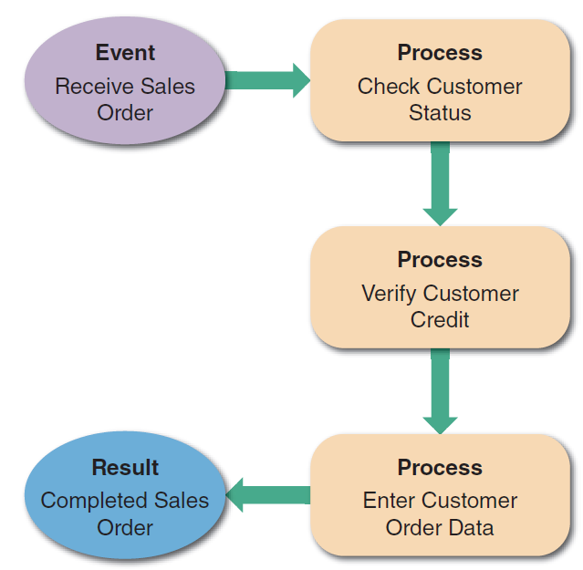
Modeling Business Operations (2 of 3)
FIGURE 1-7 A simple business model might consist of an event, three processes, and a result.

Slide 17
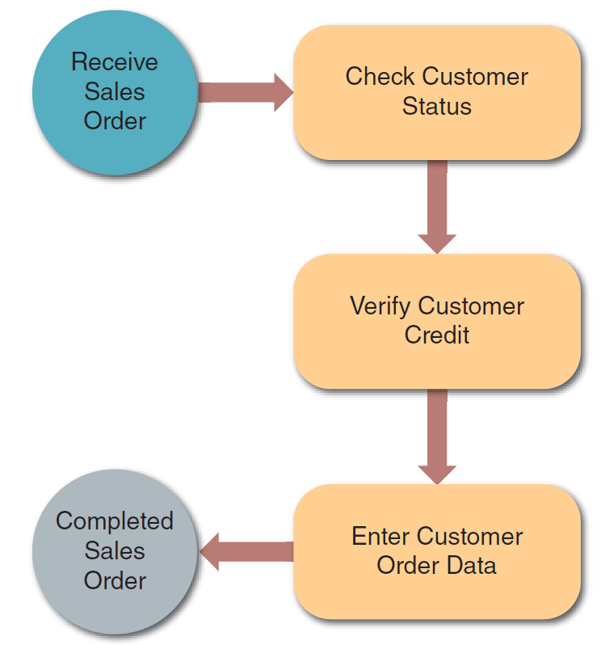
Modeling Business Operations (3 of 3)
FIGURE 1-8 This sample uses business process modeling notation (BPMN) to represent the same events, processes, and workflow shown in Figure 1-7.
Source: Drawio.com

Slide 18
Business Information Systems (1 of 5)
Current method
All employees use office productivity systems
Operational users require decision support systems
Systems are defined by functions and features
Enterprise computing
Supports company-wide operations and data management requirements
Enterprise resource planning (ERP) systems provide cost-effective support for users and managers throughout the company

Slide 19
Business Information Systems (2 of 5)
Transaction processing (TP) systems
Processes data generated by day-to-day business operations
Customer order processing, accounts receivable, and warranty claim processing
Business support systems
Provide job-related information support to users at all levels of a company
Management Information Systems (MIS)
Radio frequency identification (RFID)

Slide 20
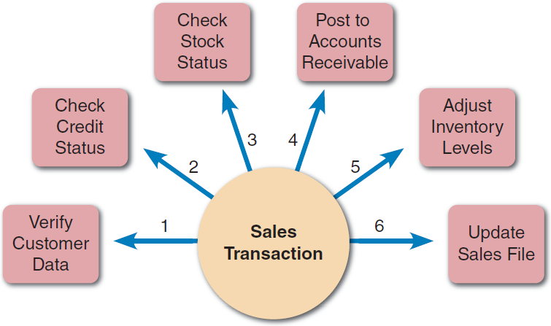
Business Information Systems (3 of 5)
FIGURE 1-11 A single sales transaction consists of six separate tasks, which the TP system processes as a group.

Slide 21
Business Information Systems (4 of 5)
Knowledge management
Uses a knowledge base and inference rules
Knowledge base: large database that allows users to find information by entering keywords
Inference rules: identify data patterns and relationships

Slide 22
Business Information Systems (5 of 5)
User productivity systems
Technology that improves productivity
Groupware: enables data sharing
Digital assistants
Combinations of knowledge management systems and user productivity systems
Systems integration
Combination of transaction processing, business support, knowledge management, and user productivity features

Slide 23
Organizational Information Models (1 of 3)
Functions and organizational levels
Defined in a typical organizational model
Top managers
Develop long-range strategic plans
Middle managers and knowledge workers
Middle managers provide direction, resources, and performance feedback to supervisors and team leaders
Knowledge workers provide support for the organization’s basic functions

Slide 24
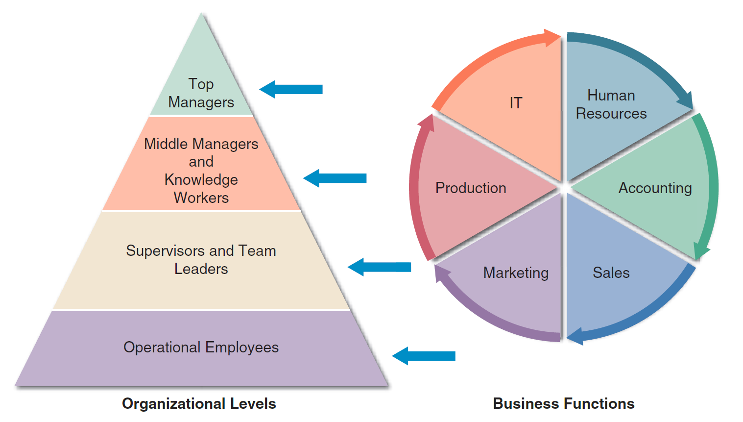
Organizational Information Models (2 of 3)
FIGURE 1-16 A typical organizational model identifies business functions and organizational levels.

Slide 25
Organizational Information Models (3 of 3)
Supervisors and team leaders
Oversee operational employees and carry out day-to-day functions
Operational employees
Rely on TP systems to enter and receive data they need to perform their jobs
Empowered to handle tasks and make decisions that were assigned previously to supervisors

Slide 26
Systems Development (1 of 3)
Structured analysis
Used systems development life cycle (SDLC)
plan, analyze, design, implement, and support an information system
Object-oriented analysis
Combines data and processes as objects
Agile methods
Build a series of prototypes and constantly adjusts them to user requirements
Spiral model

Slide 27
Systems Development (2 of 3)
Prototyping
Early working version of an information system
Disadvantage: important decisions might be made before business or IT issues are thoroughly understood
Prototypes based on careful fact-finding and modeling techniques can be extremely valuable

Slide 28
Systems Development (3 of 3)
Tools
Computer-Aided Systems Engineering (CASE) tools
Computer-aided software engineering
Provide an overall framework
Support design methodologies
Generate program code

Slide 29
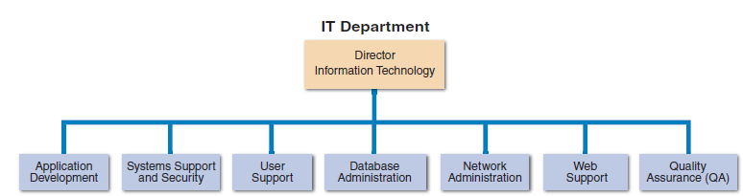
The Information Technology Department (1 of 4)
FIGURE 1-26 Depending on its size, an IT department might have separate organizational units for these functions, or they might be combined into a smaller number of teams.

Slide 30
The Information Technology Department (2 of 4)
Application development
Systems are developed by teams consisting of users, managers, and IT staff members
Systems support and security
Provides vital protection and maintenance services
User support
Provides users with technical information, training, and productivity support
Known as a help desk

Slide 31
The Information Technology Department (3 of 4)
Database administration
Involves data design, management, security, backup, and access
Network administration
Includes hardware and software maintenance, support, and security
Web support
Specialists design and construct web pages, monitor traffic, and manage hardware and software

Slide 32
The Information Technology Department (4 of 4)
Quality assurance (QA)
QA team reviews and tests all applications and systems changes to verify specifications and software quality standards

Slide 33
The Systems Analyst (1 of 4)
Investigates, analyzes, designs, develops, installs, evaluates, and maintains a company’s information systems
Constantly interacts with users and managers within and outside the organization

Slide 34
The Systems Analyst (2 of 4)
Roles
Acts a translators to managers and programmers
Best line of defense in an IT disaster
Most valuable skill: ability to listen
Seeks feedback from users to ensure that systems do not go off track

Slide 35
The Systems Analyst (3 of 4)
Knowledge, skills, and education
Technical knowledge
Communication and business skills
Critical thinking skills
Education: college degree in information systems, science, or business
Some IT experience is required
Certification
Helps IT professionals learn new skills and gain recognition for efforts

Slide 36
The Systems Analyst (4 of 4)
Career opportunities
Companies will need systems analysts to apply new information technology
Explosion in e-commerce will fuel IT job growth
Important factors
Job titles
Company organization
Company size
Salary, location and future growth
Corporate culture

Slide 37
Trends in Information Technology
One of the fastest evolving industries
Knowledge of current trends is vital
Key trends
Agile methods
Cloud computing
Data science
Mobile devices
Service orientation
Social media

Slide 38
Chapter Summary (1 of 2)
Information technology (IT)
Combination of hardware, software, and services
Used to manage, access, communicate, and share information
Essential information system components
Hardware, software, data, processes, and people
Successful companies offer a mix
Products and services

Slide 39
Chapter Summary (2 of 2)
Systems analysts
Use modelling, prototyping, and computer-aided systems engineering (CASE) tools
must understand the business, think critically, and communicate effectively
Popular system development approaches
Structured analysis, object-oriented analysis, and agile methods

